Slide 1

DON BOSCO INSTITUTE OF TECHNOLOGY Dept of Computer Science
HANDWRITTEN TEXT PATTERN RECOGNITION SYSTEM
Presented by:
Anurag G 1DB16CS023
C Sagar Patil 1DB16CS042
Harsha J K 1DB16CS056
Deepak S D 1DB17CS403
Under the Guidance of
Asst.Prof. HEMALATHA M
Dept. of CSE

Slide 2
Introduction
Hand-written text pattern recognition is considered as one of the method to communicate between man and machine.
In handwriting recognition (HWR) the device interprets the user's handwritten characters or words into a format that the computer understands.
Many methods or models are provided to recognize text with various accuracy.
Performance of the system is determined depending on attributes such as the size of the text, the writing style, and the rate of recognition.
Web based application is used in our project that uses the text written image to display the results identified.
2

Slide 3
Aims
The main aim of this project is to build a hand-written text pattern recognition system.
The system accepts an image, recognizes the text written in the image and converts
it into a digital formatted text and gives it as an output.
3

Slide 4
Objectives
Implementing Convolutional neural network(CNN) model to have a system that can recognize the hand-written text patterns with a high recognition rate.
Reduce the number of classification errors in transcribing these handwritten digits and reduce the time taken to complete this task.
Handwritten text is converted into digital format to increase the readability of any written text.
4

Slide 5
Literature Survey
An early notable attempt in the area of character recognition research is by Grimsdale in 1959. The origin of a great deal of research work in the early sixties was based on an approach known as analysis-by-synthesis method suggested by Eden in 1968.
K. Gaurav and Bhatia P. K’s “Analytical Review of Preprocessing Techniques for Offline Handwritten Character Recognition”, this paper deals with the various pre-processing techniques involved in the character recognition with different kind of images ranges from a simple handwritten form based documents and documents containing colored and complex background and varied intensities. In this, different preprocessing techniques like skew detection and correction, image enhancement techniques of contrast stretching, binarization, noise removal techniques, normalization and segmentation, morphological processing techniques are discussed.
5

Slide 6
Salvador España-Boquera, Maria J. C. B., Jorge G. M. and Francisco Z. M., “Improving Offline Handwritten Text Recognition with Hybrid HMM/ANN Models”, in this paper hybrid Hidden Markov Model (HMM) model is proposed for recognizing unconstrained offline handwritten texts yielding a 88.8% of accuracy for lexicon size 40,000. In this, the structural part of the optical model has been modelled with Markov chains, and a Multilayer Perceptron is used to estimate the emission probabilities. In this paper, different techniques are applied to remove slope and slant from handwritten text and to normalize the size of text images with supervised learning methods. The key features of this recognition system were to develop a system having high accuracy in preprocessing and recognition, which are both based on ANNs.
6

Slide 7
Existing System
The present system doesn’t use modern technology & tools. and has low accuracy which makes the model not usable in real time.
In existing system preprocessing of data is time consuming.
The existing system has low accuracy which makes the model not usable in real time.
7

Slide 8
Proposed System
The proposed system identifies the text by the image which is selected and uploaded from the local storage.
The system recognizes the image and gives the output in a digitalized text format which can be further converted to human speech.
The time consumed for training the model has been reduced and accuracy has been increased.
Progressive Web App has been implemented for user interaction which reduces the scope of mobile ﬁrst approach.
8

Slide 9
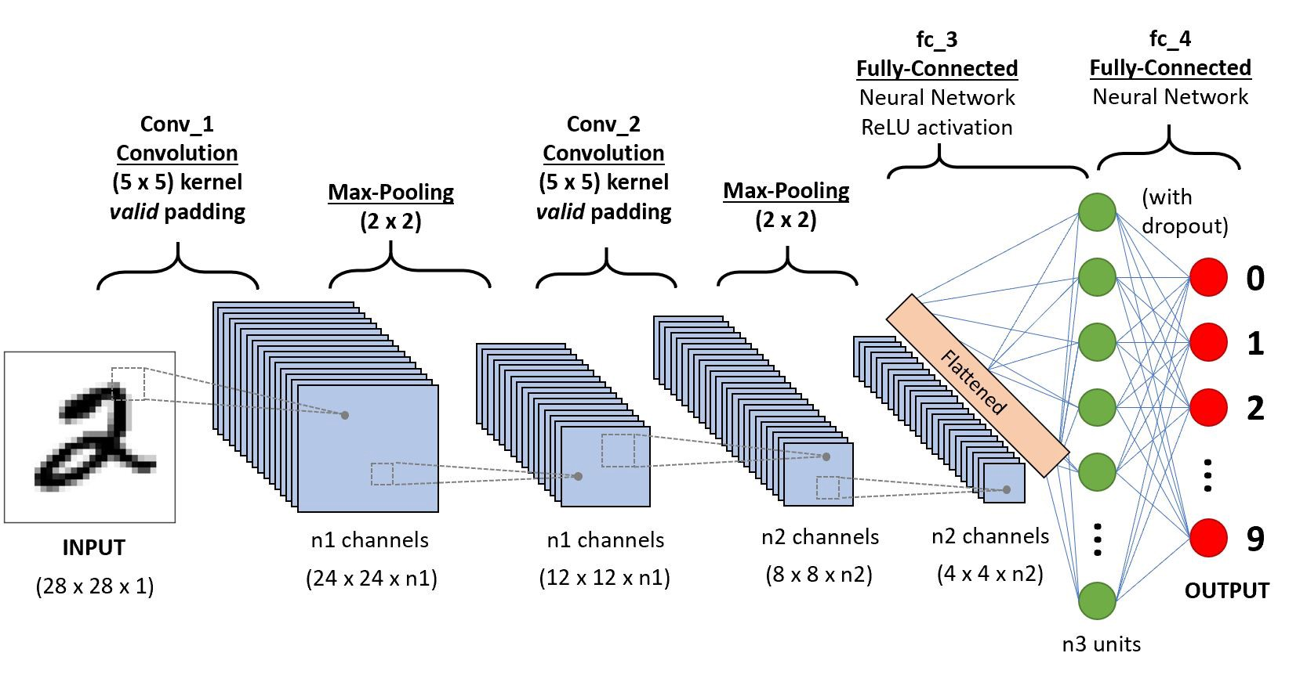
System Design
Illustration of the image classification using CNN architecture
9

Slide 10
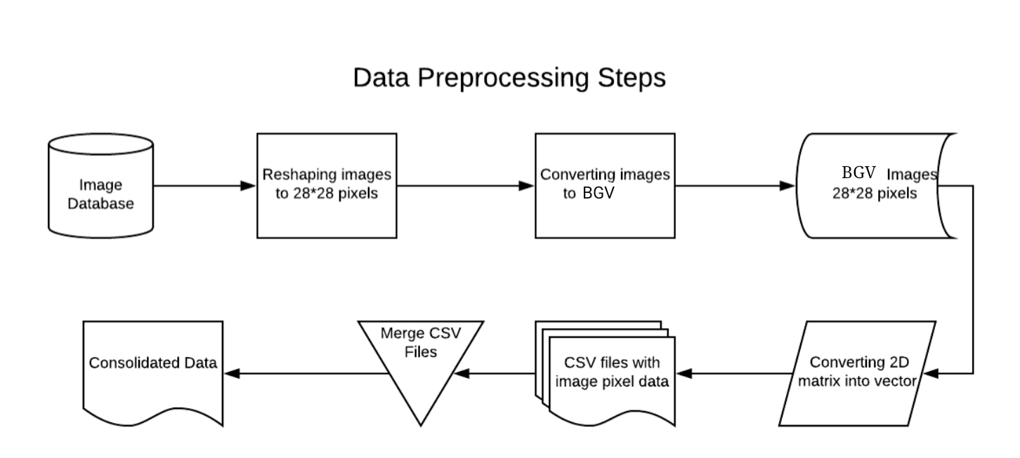
System Design
10

Slide 11
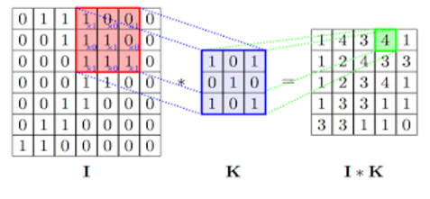
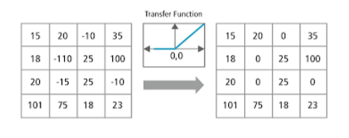
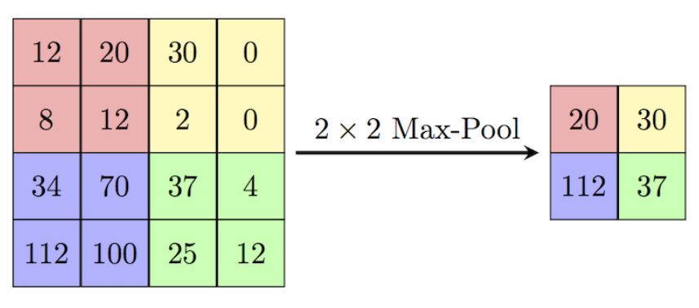
System Design
Convolution step
ReLu(Rectifier Linear Units)
Max pooling
11

Slide 12
Implementation
Flask Server on PORT 5000
Jinja2 Template engine
Keras is used to load Machine Learning Model into the server
12

Slide 13
Modules
Jinja2 Template engine
CSS Frameworks
Representational State Transfer
Fetch API
Model Architecture – Convolutional Neural Networks
13

Slide 14

Results
Snapshot-1
14

Slide 15

Snapshot-2
15

Slide 16

Snapshot-3
16

Slide 17
Conclusion
An online handwriting recognition system for English based characters has been developed. The system is writer-independent text recognizer developed based on convolutional neural network approach with text-to-speech conversion system.
Future work
The proposed work can be extended to work on degraded text or broken characters.
The system could be designed to recognize the writer and thus can lead to achieve signature recognition which can be used in bank check processing.
Language translation system can be implemented to covert the language into another desired language.
17

Slide 18
REFERENCES
Proceedings of the 2nd International Conference on Inventive Communication and Computational Technologies (ICICCT 2018), IEEE Xplore - Handwritten Character Recognition Using Deep-Learning.
International Journal of Management, Technology And Engineering Volume 8, Issue VII, JULY/2018 ISSN NO : 2249-7455.
NIST Handprinted Forms and Characters Database obtained by,
https://www.kaggle.com/sachinpatel21/az-handwritten-alphabets-in-csv-format
https://medium.com/@himanshubeniwal/handwritten-digit-recognition-using-machine-learning-ad30562a9b64
18

Slide 19
THANK YOU
19

